Slide 1
Exploratory Testing
Prepared by: Rafał Nikiel
6 November 2015
Version: 1.0

Slide 2

Agenda
What’s wrong with scripted testing ?
What is exploratory testing
SBTM
Task 2
Summary

Slide 3
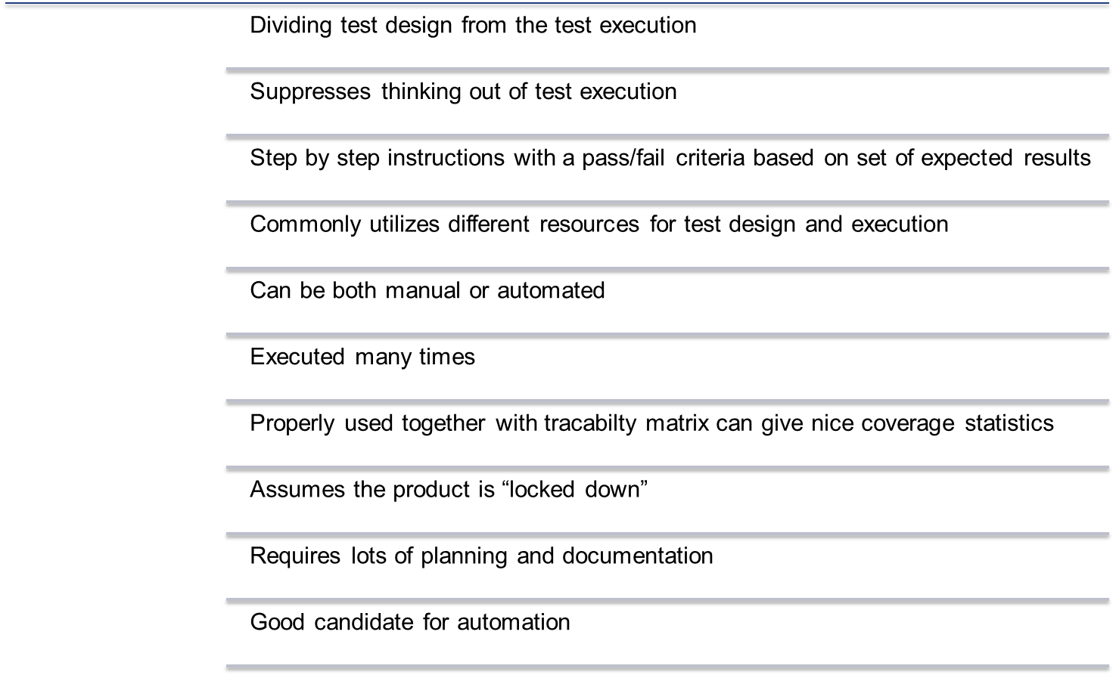
Scripted testing – quick summary

Slide 4
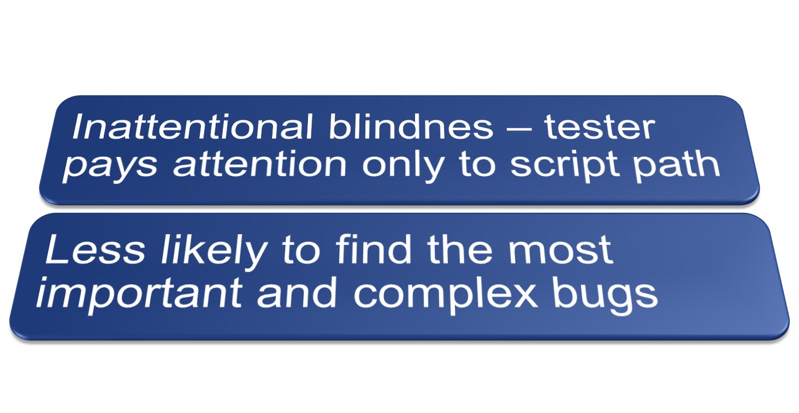
Scripted testing – what’s wrong with this approach?
Excercise

Slide 5
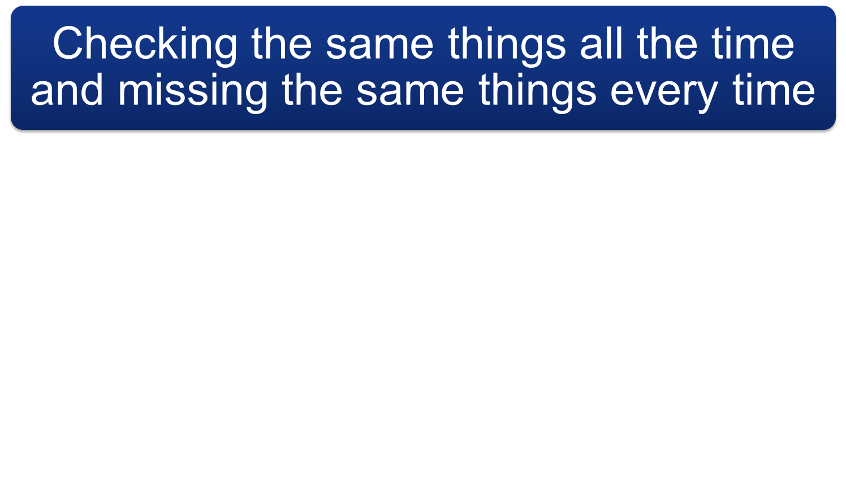
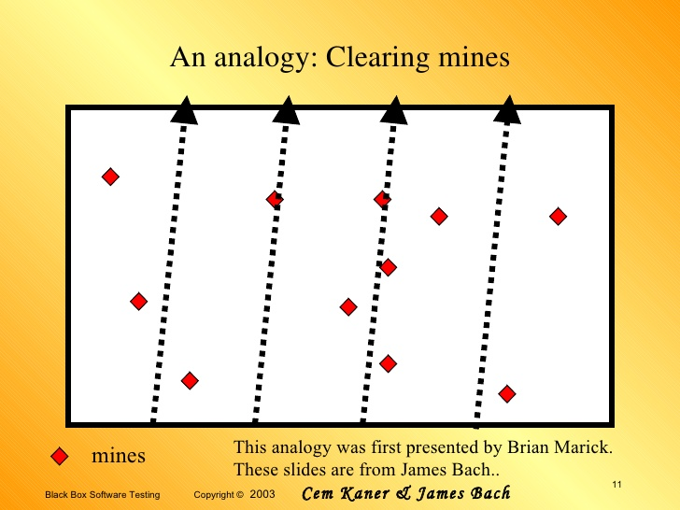
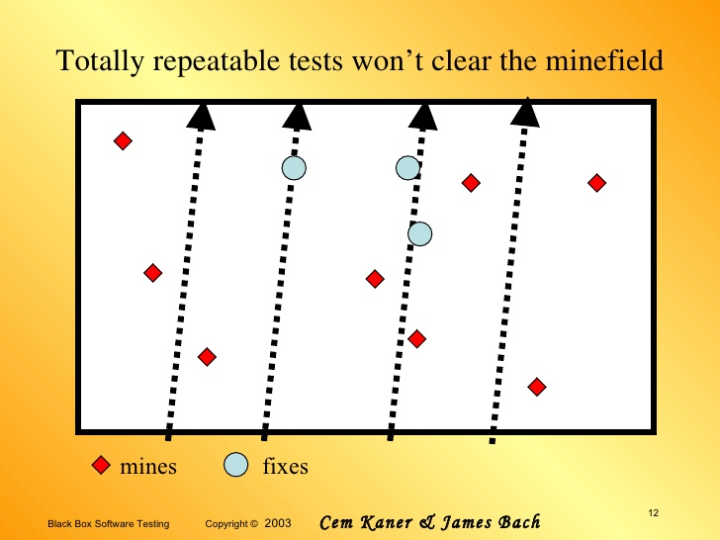
Scripted testing – what’s wrong with this approach?
Notes:
Clearing mines – what if pareto rule will be applied and most of the bugs will appear in one area (not covered by the script)?
If you imagine a product as a field of landmines and each landmine is a defect, then it’s pretty clear that treading the same path over and over is not the way to find them all

Slide 6
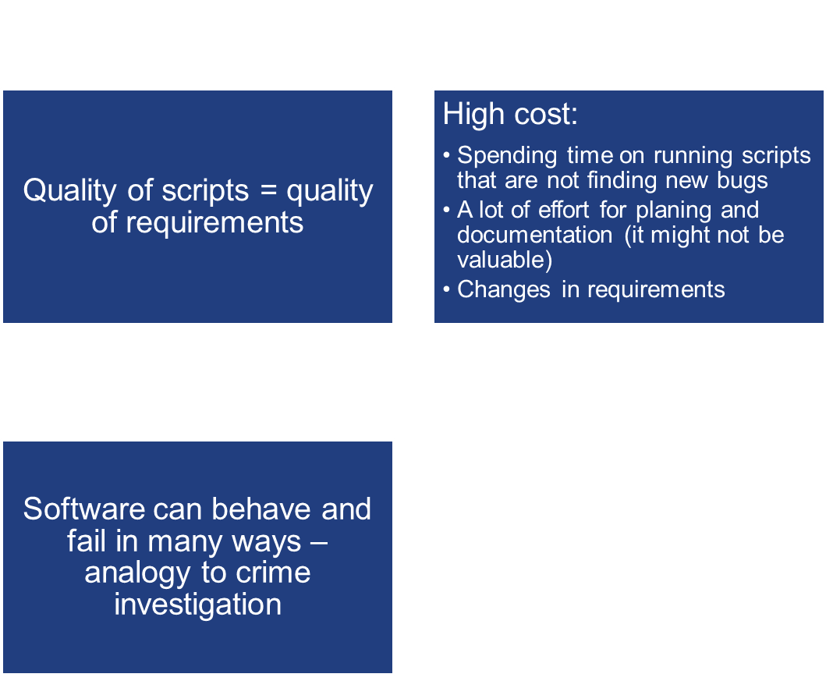
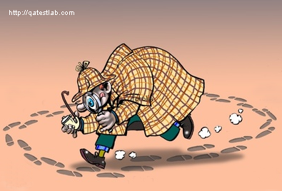
Scripted testing – what’s wrong with this approach?
"Not everything that can be counted counts and not everything that counts can be counted.„
A. Einstein

Slide 7
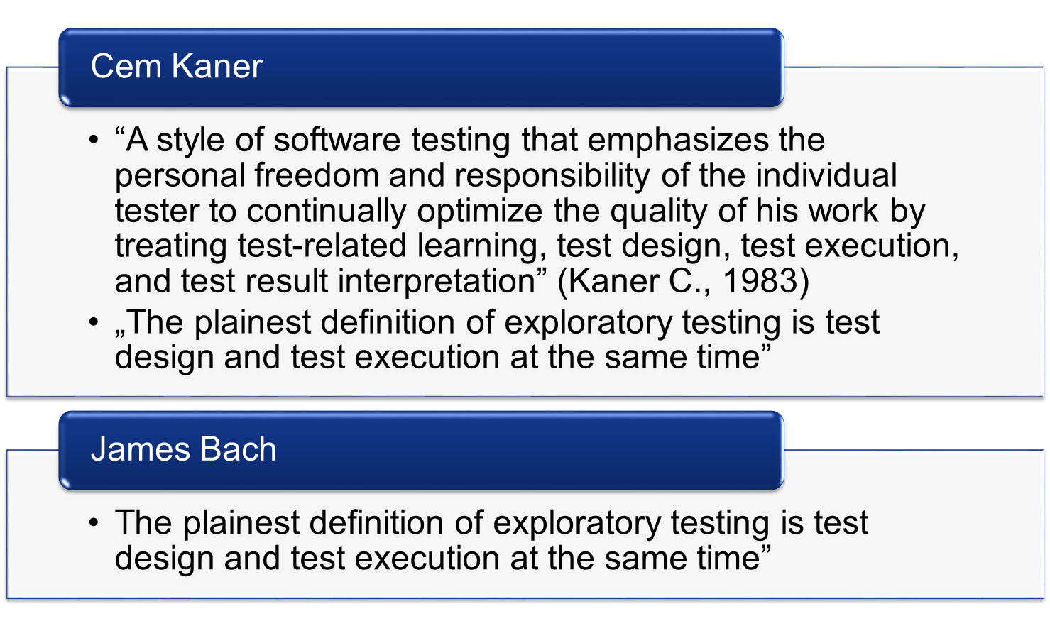
Exploratory testing – definitions

Slide 8
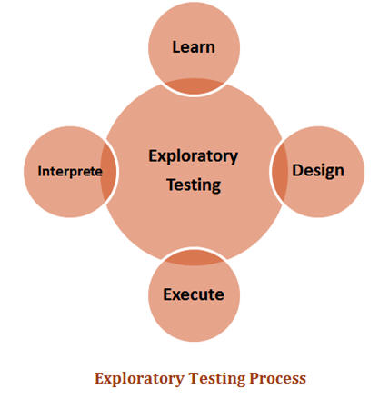
Exploratory testing explained
Exploratory testing is not a testing technique. It's a way of thinking about testing.
Test are designed and executed at the same time
Using conclusion from the fist test as an input to second one
Testers are in control not the test script
Spend more of your tester’s time on core testing activities
Everyone was performing exploratory tests
Tools and techiques – total freedom
ET is not „do random stuff and see what happens”
„If all you have is a hammer, everything loks like a nail”
Notes:
ET jest jak gra w szachy kolejny ruch zawsze zależy od ruchu przeciwnika i aktualnego stanu gry

Slide 9
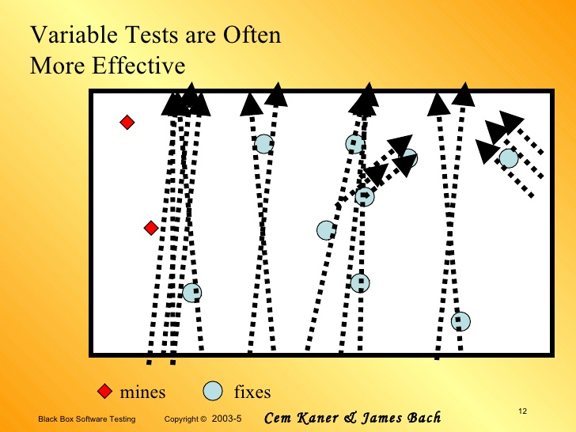
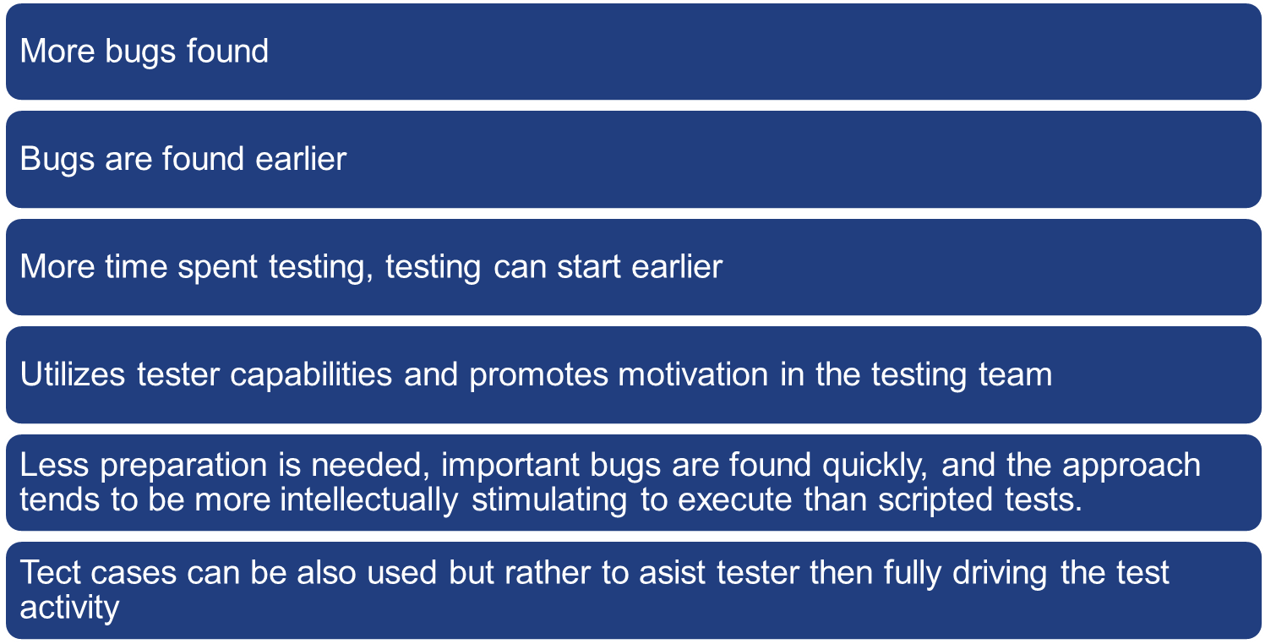
Exploratory testing benefits

Slide 10
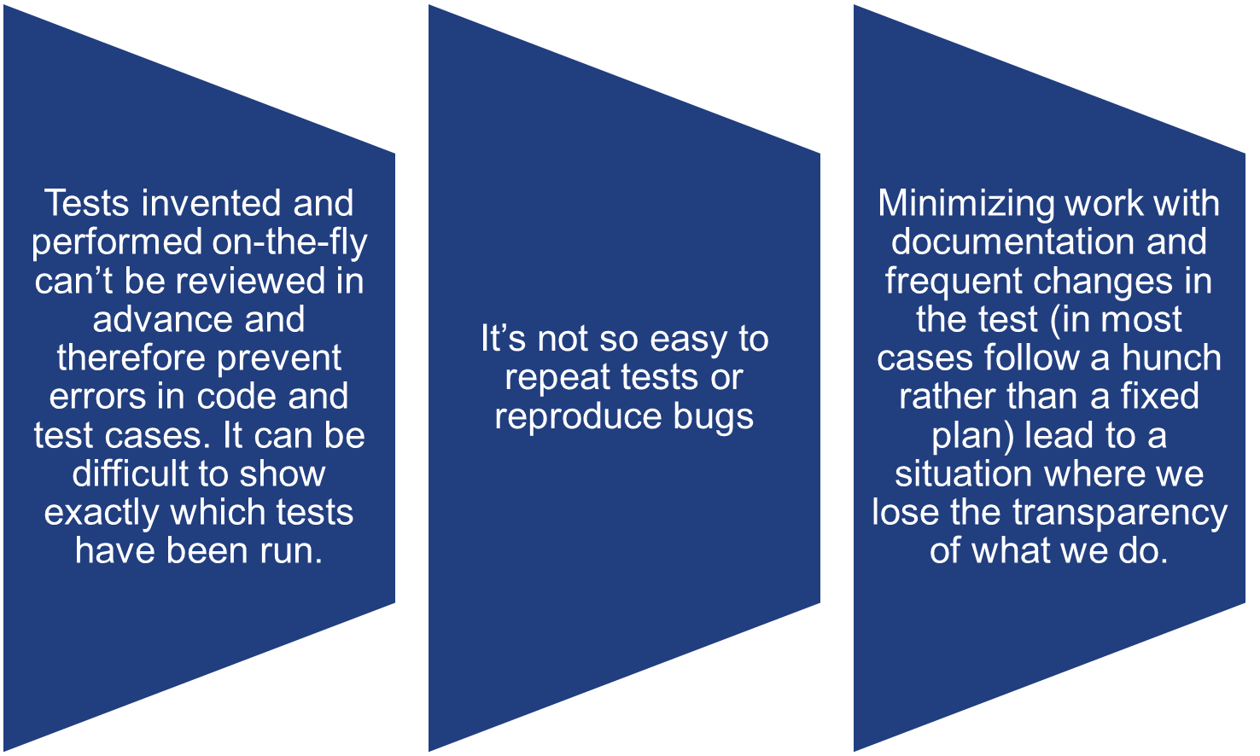
Exploratory testing - cons

Slide 11
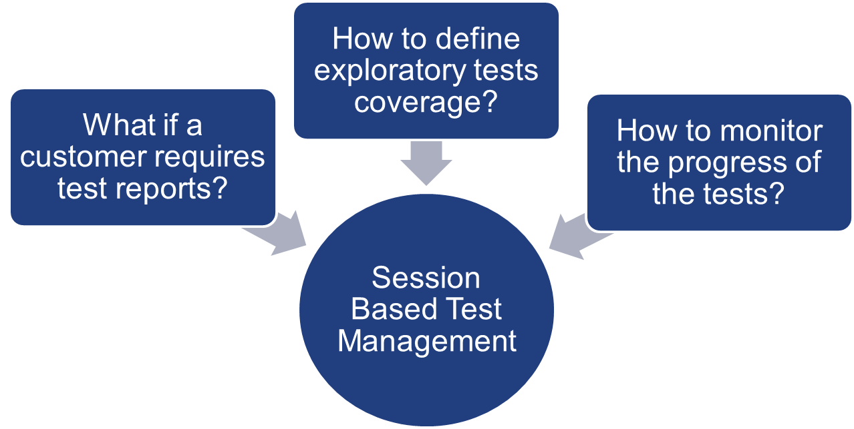
Exploratory testing - chalenges

Slide 12
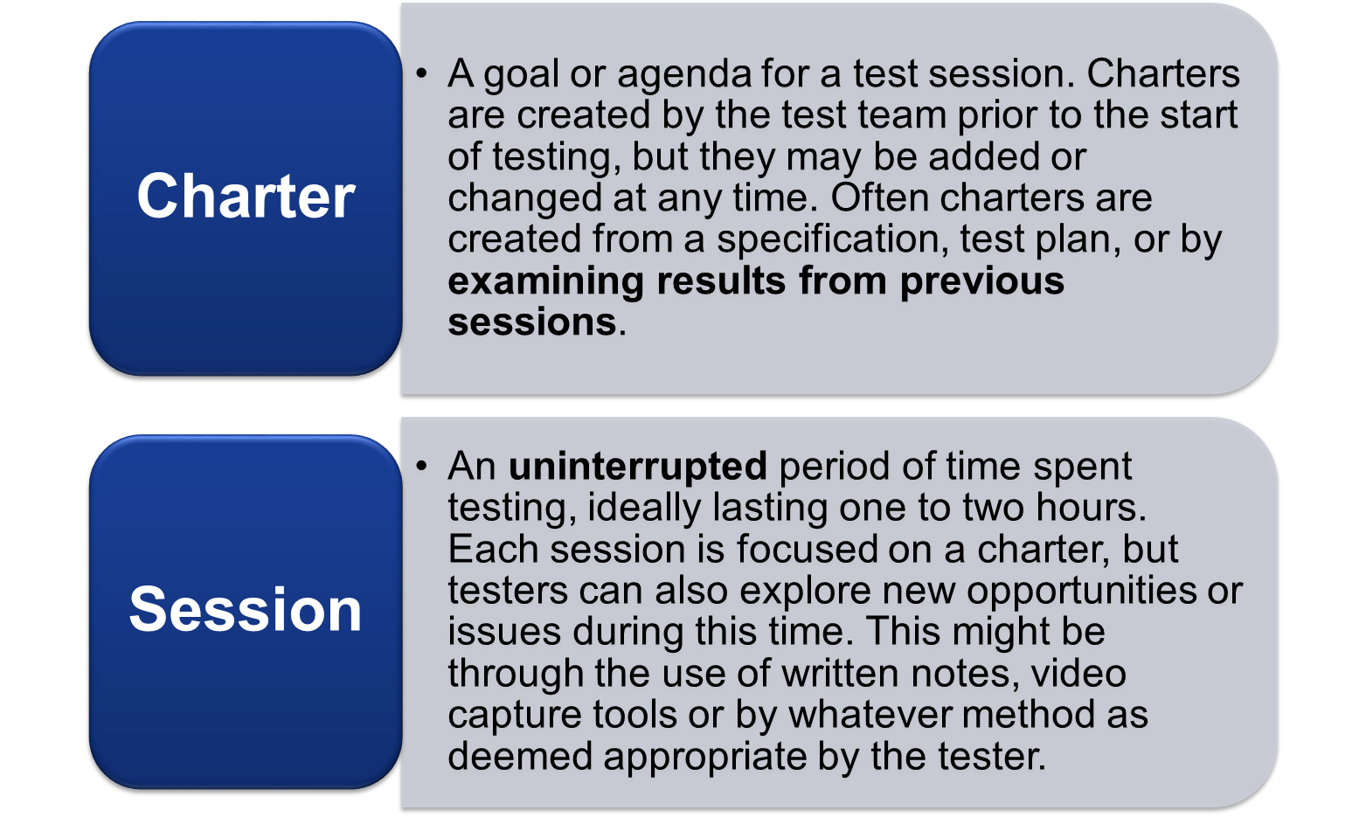
SBTM - main concept
Notes:
Jak powstalo – Bach – zespol od zadan specjalnych. Szybkie znajdywanie bugow ale rowniez raporty z postepu prac dla klienta.
Notatki powinny zawierac fakty, krotkie tresciwe opisy tego na co tester natrafia podczas pracy

Slide 13
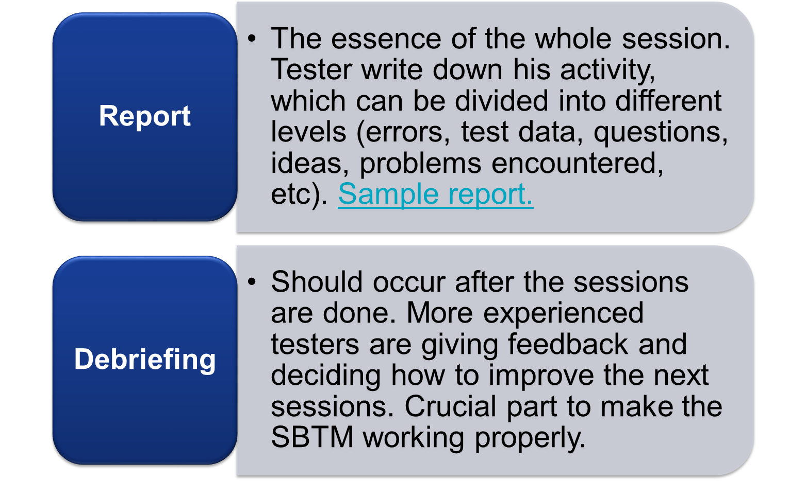
SBTM - main concept
Notes:
Jak powstalo – Bach – zespol od zadan specjalnych. Szybkie znajdywanie bugow ale rowniez raporty z postepu prac dla klienta.
Notatki powinny zawierac fakty, krotkie tresciwe opisy tego na co tester natrafia podczas pracy

Slide 14
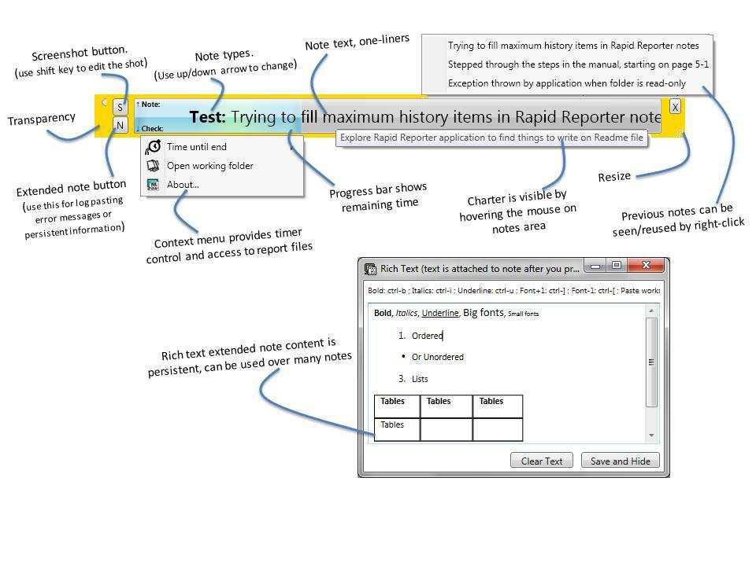
SBTM tools – Rapid reporter
http://testing.gershon.info/reporter/

Slide 15
Task 1
Go to http://www.orangehrm.com/OpenSource.php and expand Features
Chose one of the feature and read the short spec of that functionality
Run Rapid reporter and define your charter
Open following link http://opensource.demo.orangehrmlive.com/
Run your session and remember to take some notes
Convert session report to html format
Send all reports in html format to rafal.nikiel@gft.com or to https://github.com/jacekokrojek/math.uni.lodz.pl

Slide 16
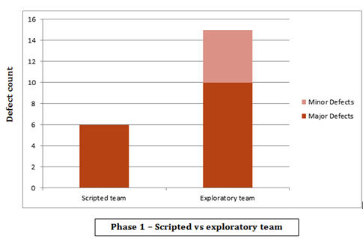
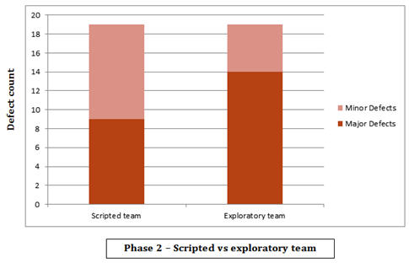
Exploratory testing - Summary
Scripted vs exploratory experiment:
  2 teams, 2 aproaches 2 testing phases
  In the end, neither approach was perfect, because each team reported defects that the other team did not identify, even if the exploratory team did report more, overall.

Slide 17
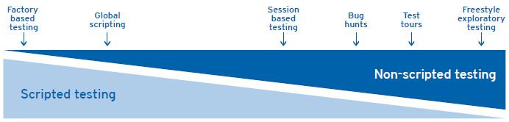
Exploratory testing - Summary
So which approch is the best scripted or exploratory ?
Examples from real world

Slide 18
Exploratory testing - links and materials
http://www.testingeducation.org/BBST/exploratory/BBSTExploring.pdf
http://www.satisfice.com/articles/sbtm.pdf
http://www.kaner.com/pdfs/QAIExploring.pdf
http://www.satisfice.com/articles/what_is_et.shtml
http://www.satisfice.com/articles/et-article.pdf
http://www.testingeducation.org/a/nature.pdf

Slide 19
Thank you!

